Slide 1





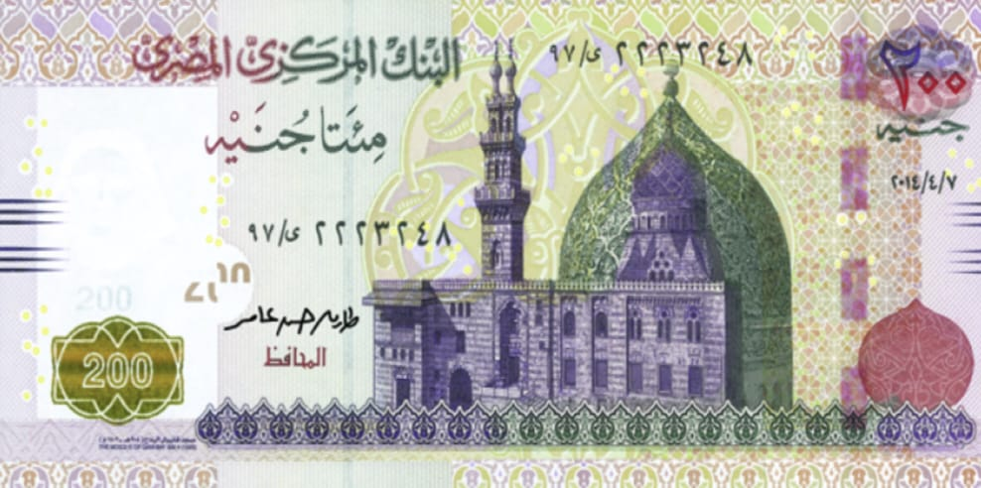
FAKE CURRENCY Using Edge Detection By Heptacone
MTH1172 Project
Submitted to:
Dr. Samah El-Tantawy

Slide 2
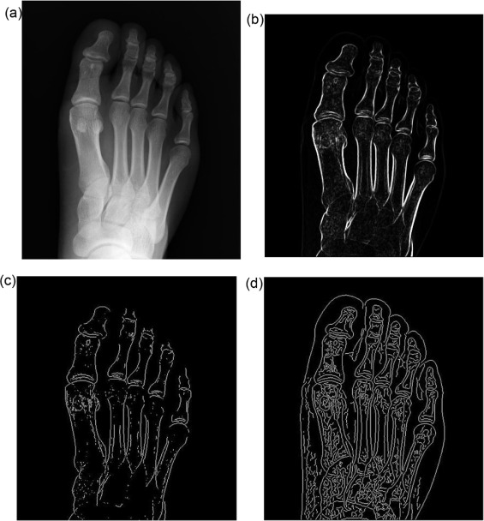
Introduction
What is Edge detection ?
Why Edge Detection ?
1

Slide 3
OUTLINES
Results and Analysis
Literature Review
Algorithm
Future work
02
04
01
03
2

Slide 4
Literature Review
01
A study and comparison about different edge detection techniques
02
Overview of Edge Detection Algorithms Based on Deep Learning
Fingerprint Recognition
03
Automated new license plate recognition in Egypt
04
3

Slide 5
Algorithm
Image Acquisition
Gray Scale Conversion
Edge Detection
Characteristic Extraction
Image Segmentation
Comparison
4

Slide 6
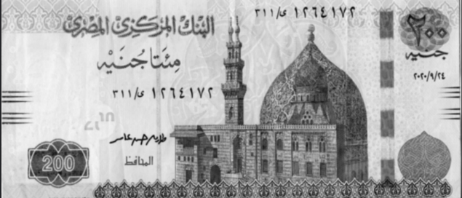
Image Acquisition
Gray Scale Conversion
Convert a colored image into gray image
5

Slide 7
Edge Detection
Types of edge detection algorithms
Gaussian-based
Gradient-based
6

Slide 8
Canny Edge detection
Why?
Unmatched Precision and Flexibility

Slide 9
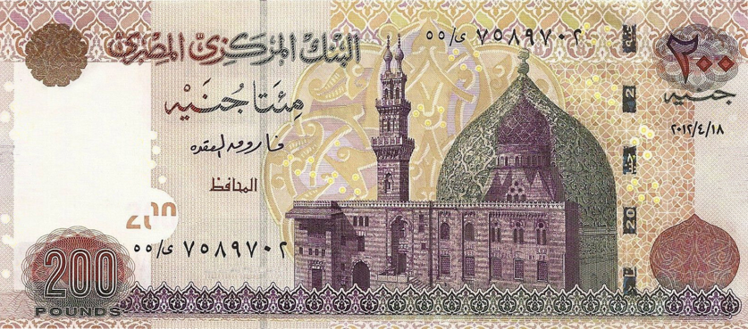

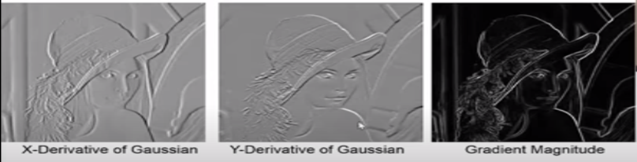




Canny Edge Detection
1. Noise Reduction (Image smoothening)
2. Calculating Intensity Gradient
Calculating the Sobel gradient on X & Y directions of the image
Magnitude(S) =$\sqrt{s_{x}^{2}+s_{y}^{2}}$
Direction(${θ\text{)}=tan}^{−1}{\frac{s_{y}}{s_{x}}}$
$G\left(x,y\right){=\frac{1}{2πσ^{2}} e}^{\frac{x^{2}+y^{2}}{2σ^{2}}}$
$$σ:$$
Constant added according to different applications and different libraries
8

Slide 10
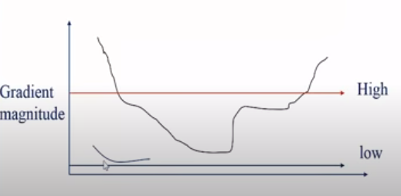




Canny Edge Detection
3. Non-maximum Suppression
4. Hysteresis Threshold
$M\left(x,y\right)=\left\{\begin{matrix}\begin{aligned}\left|∇S\right|\left(x,y\right) if \left|∇S\right|\left(x,y\right)>\left|∆\dot{S}\right|\left(\dot{x},\dot{y}\right) \\ or &\left|∆S\right|\left(x,y\right)>\left|∆\ddot{S}\right|(\ddot{x},\ddot{y}) \end{aligned} \\ 0 otherwise \end{matrix}\right\}$
Removing all weak edges
$$(x^{′},y^{′})$$
$$(x,y)$$
$$(x^{′′},y^{′′})$$
9

Slide 11
Image Segmentation
Input Image
Object 1
Object 2
Object 3
Object n
10

Slide 12
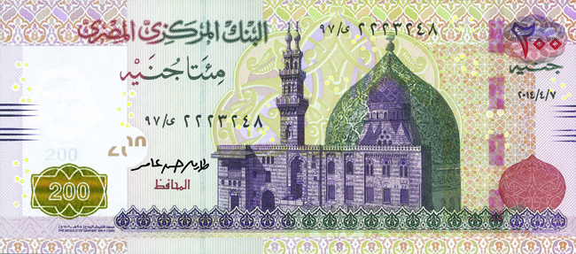
Feature Extraction
1. See Through Register
5. Intaglio Lines
4. Latent Image
2. Microtext
3. Security Ink
11

Slide 13
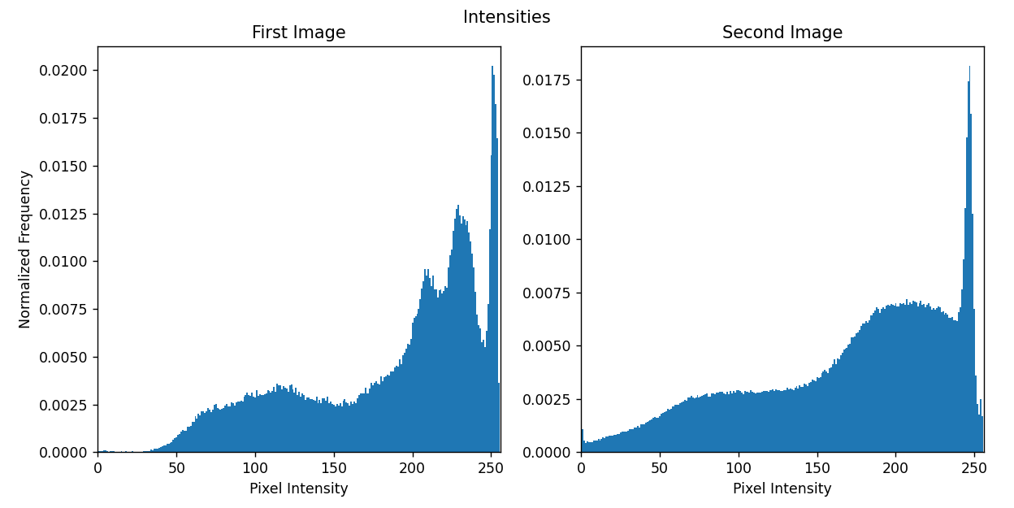

Comparison
1. Intensity Difference
$$\frac{1}{n}\sum_{1}^{n}{(I_{1}\left(n\right)−I_{2}(n))}$$
I: Intensity of segment
n: Number of segments
12

Slide 14
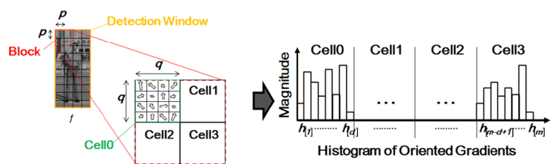



2. HOG Distance
$$\text{HOG} \text{distance}\text{ =}\sqrt{\sum_{i=1}^{m}{{\left(H1\left[i\right]−H2\left[i\right]\right)}^{2}}}$$
$$\left\|∇f\right\|=\sqrt{{\left(\frac{∂f}{∂x}\right)}^{2}+{\left(\frac{∂f}{∂y}\right)}^{2}}$$
f = The original image
$∇$f = Curl f
m = Total number of bars in the histogram
H1 = The histogram of the reference currency image
H2 = The histogram of the test currency image
13

Slide 15
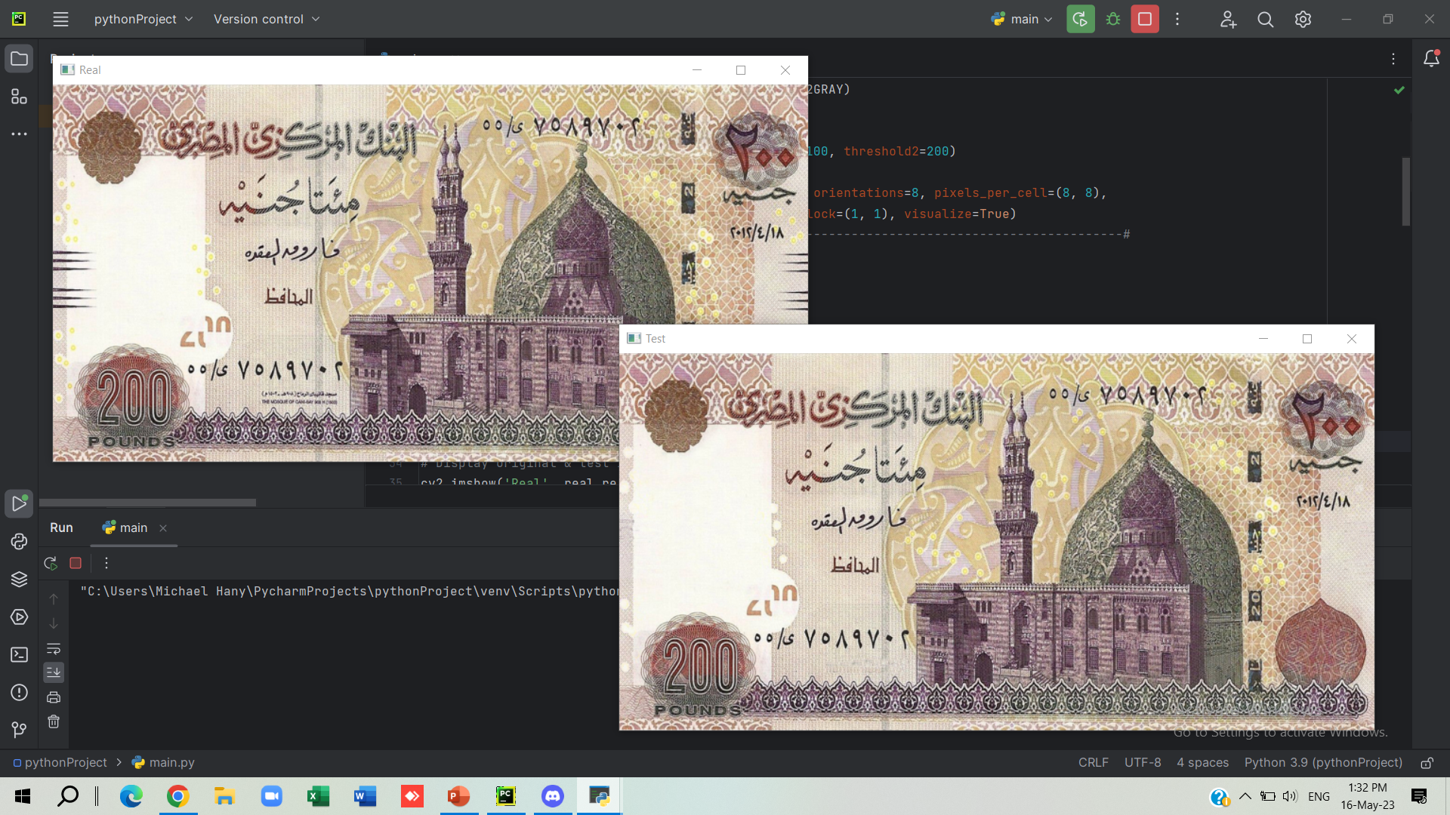

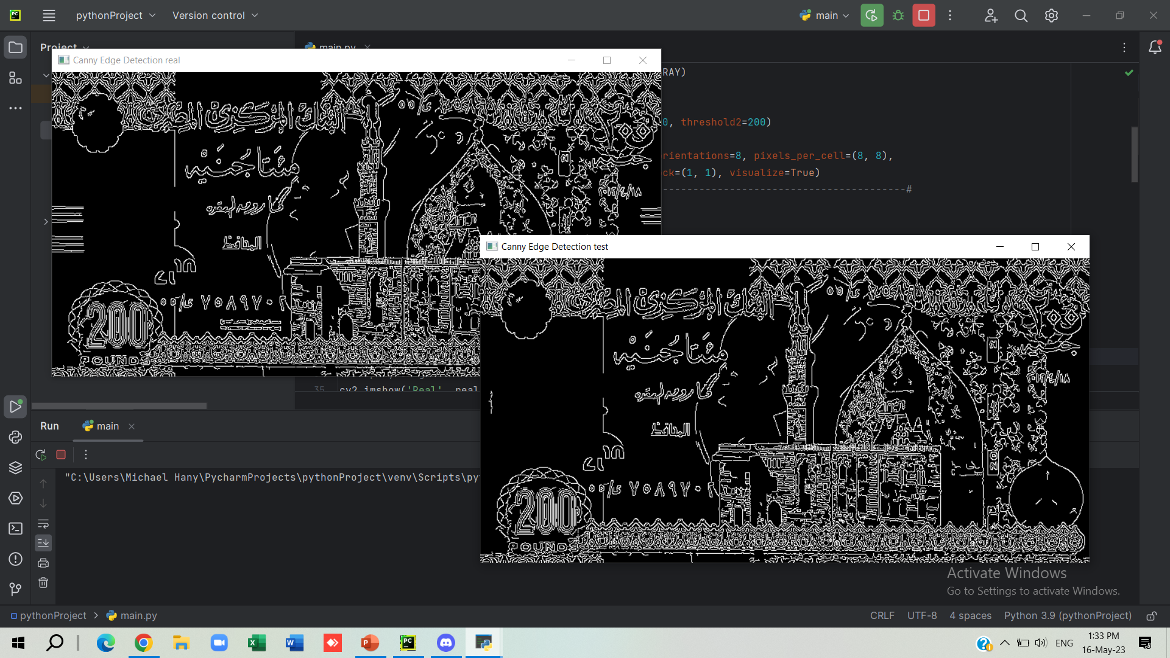
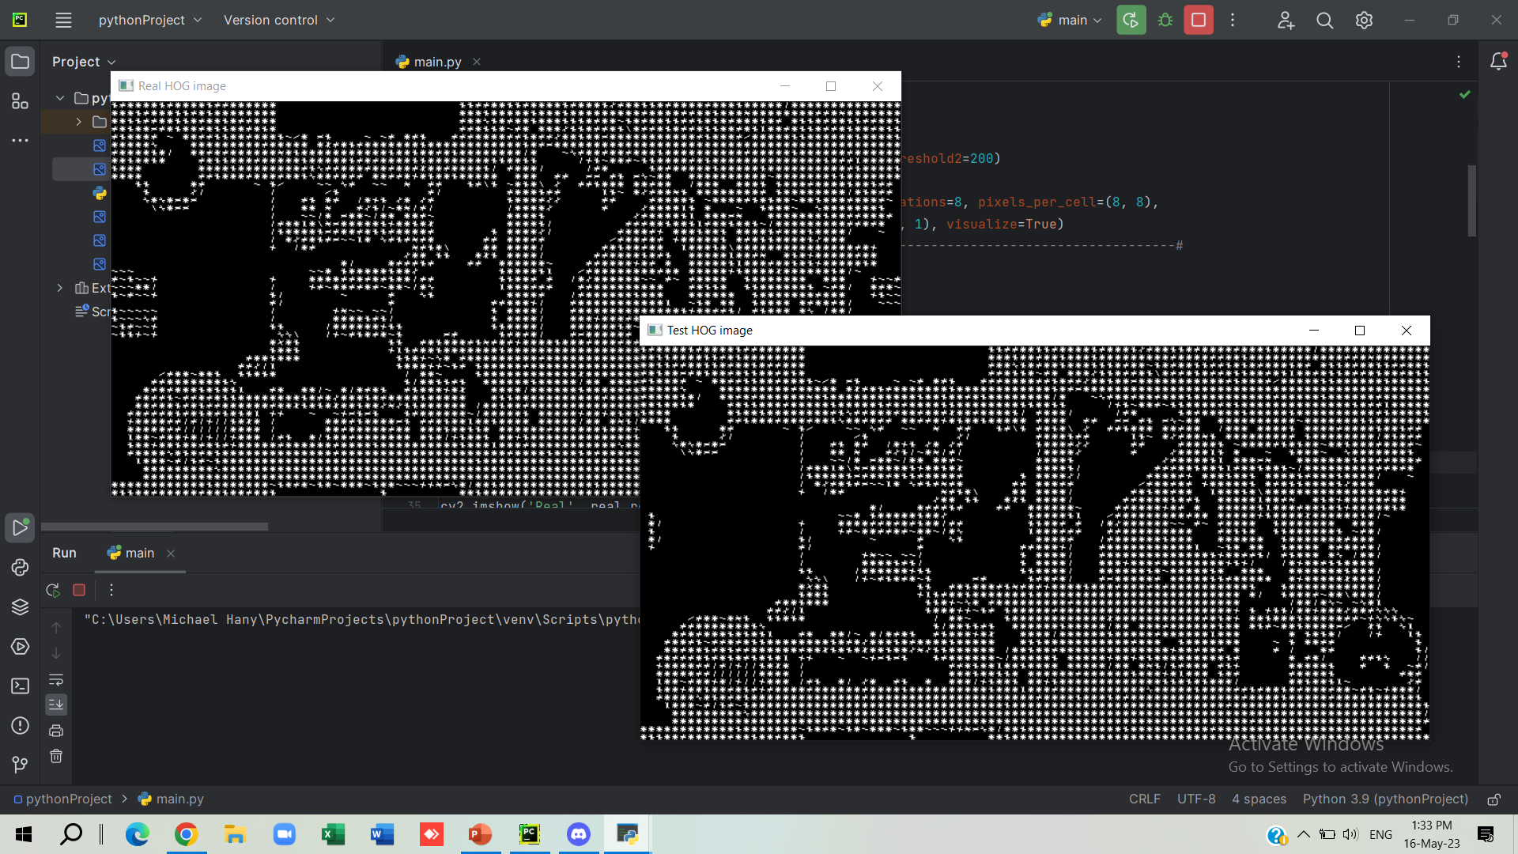
Results & Analysis
14

Slide 16
Step 1: Acquiring Images
15

Slide 17
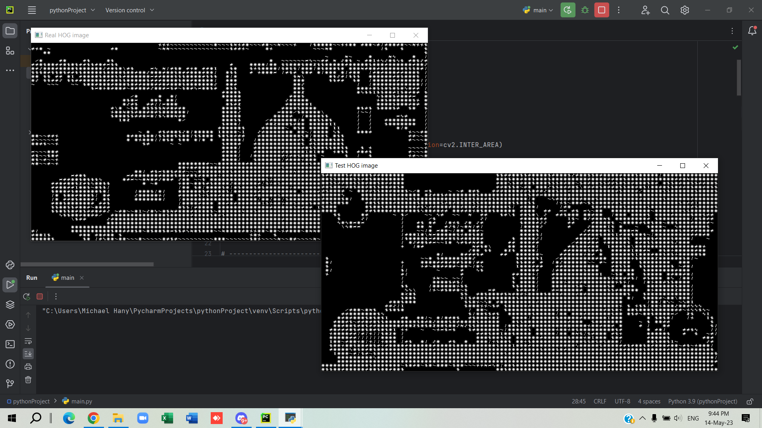
Step 2: Gray Scale
16

Slide 18
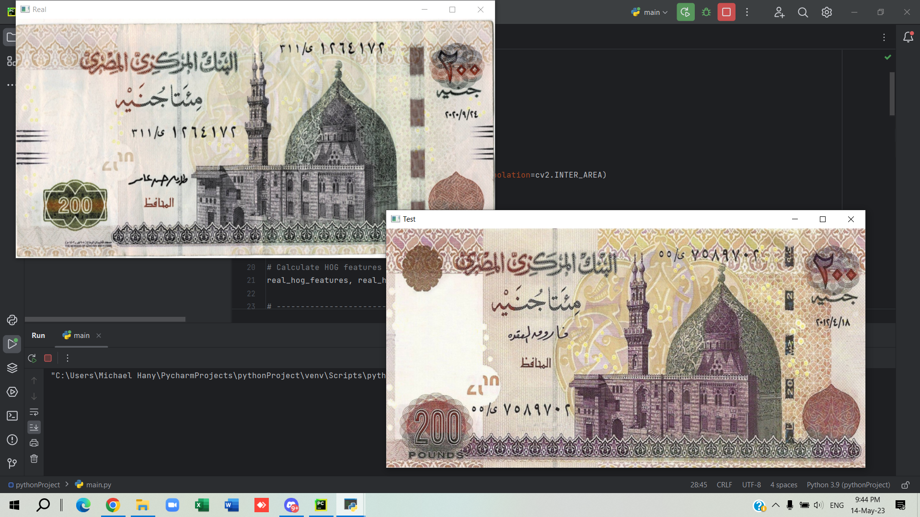
Step 3: Edge Detection
17

Slide 19
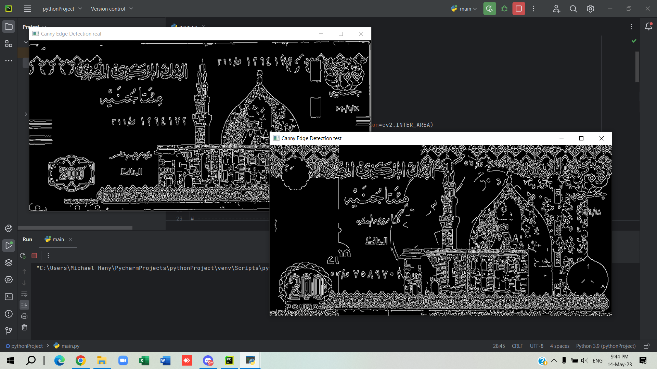

Step 4: HOG Distance
18

Slide 20
Results & Analysis
Observation
When we experimented on low quality images the results where greatly affected
19

Slide 21
Conclusion & Future Work
Edge detection using canny can successfully be used for fake currency recognition.
Limitations such as low-quality input images can cause detection technology to fail, so it is necessary to check specific image specifications to ensure program success.
As a future work, we can use machine learning by training it on a large dataset and optimizing for real-time implementation.
20

Slide 22
Any Questions ?
Any Questions ?

Slide 23
“ It is not always about how to keep your self motivated, We think it is just about how to keep your faith “ Heptacone team quote

Slide 24
Thanks
A study and comparison about different edge detection techniques
Fingerprint recognition
Automated new license plate recognition in Egypt
Overview of Edge Detection Algorithms Based on Deep Learning
A study and comparison about different edge detection techniques
Fingerprint recognition
Automated new license plate recognition in Egypt
Overview of Edge Detection Algorithms Based on Deep Learning

